Slide 1
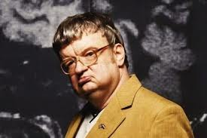
SAVANT SYNDROME
DEDICATION TO
KIM PEEK
THE REAL
“ RAIN MAN”

Slide 2
Savant syndrome
Savant syndrome is a rare condition in which people with neurodevelopmental disorders, notably autism spectrum disorders and/or brain injuries, demonstrate profound and prodigious capacities and/or abilities far in excess of what would be considered normal.

Slide 3
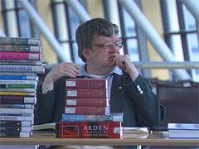
Mega-savant
Kim Peek is actually classified as a
Mega-Savant
Savant skills are usually found in one or more of five major areas: art, musical abilities, calendar calculation, mathematics and spatial skills.

Slide 4
Mega-savant
Kim has an extremely larger memory than a savant.
He knows a combination of the skills in the five major areas, not just one of them.
He can put them to use, and not just store it like a book on a shelf.

Slide 5
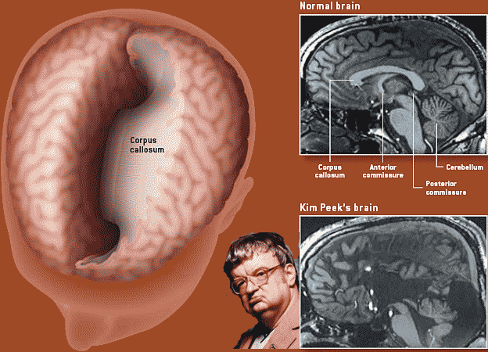
Diagnosis
Kim was also born with Macrocephaly, which is damage to the cerebellum.
He also had Agenesis to the corpus callosum, which is a condition in which the bundle of nerves between the two brain hemispheres are missing.

Slide 6
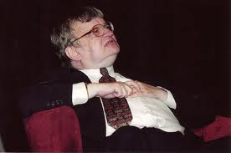
“Don’t want you to miss your golf game!”
It was so burnt into his memory, that when he is upset or nervous he writhes his hands and repeats that saying over and over.
His parents were told he would not live past 14 years old.

Slide 7
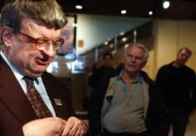
Kim went into depression and hiding.
He would not leave the house, when he did he would not look anyone in the eyes. When spoken to he would slump down in his seat.

Slide 8
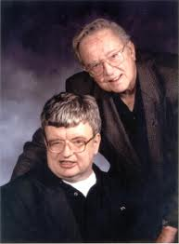
Me and my shadow
Even though Kim is known as a genius, he cannot do simple every day things. His 80 year old father, dresses him, brushes his teeth, shaves and bathes him. Since the divorce Fran took care of Kim all alone.
“ Me and my dad are the same shadow”

Slide 9
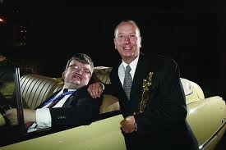
His life changed forever
While standing in line waiting to see a movie in 1994, they bumped into a notable movie director;
Barry Marrow.
Kim's life after that day was never the same !

Slide 10
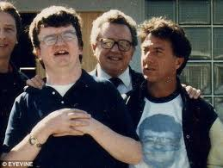
“He made me rain man !”
Barry’s only wish in trade for a movie about Kim, was that they continued to share him with the world.
Kim Peek with his
Father Fran and Dustin Hoffman
Who played Kim in the
movie “Rain Man”

Slide 11
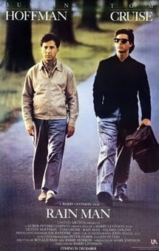
Rain man
The 1988 film “Rain Man” starring Dustin Hoffman and Tom Cruise. Dustin playing the role of Raymond Babbitt portraying the real life Kim Peek, and Tom playing his brother Charlie Babbitt.

Slide 12
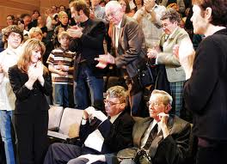
“it proves that people with disabilities really can change” Barry Morrow
After “Rain Man,” Kim really opened up. He eventually turned out to be a social sensation. Everyone knew him, and he would talk to everyone he passed.
The movie changed his life forever, and His
father Fran kept their promise to share Kim with the world.

Slide 13
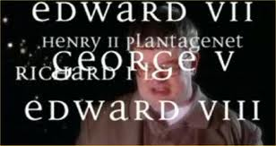
Down to business
After realizing how special Kim really was, his father decided to run him thru a battery of tests over the course of his last years. They wanted to find out as much as they could about Kim.

Slide 14
Kim's’ history doctors needed to know his past
He did not walk until 4 years old
He was unable to memorize anything from 16-20 months
His parents separated when he was young
He does not understand metaphors, he takes everything literally
He cannot reason out math problems
He had little to no social skills

Slide 15
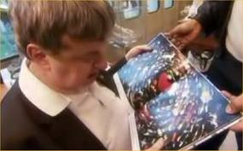
Scientific research
Brain scans were taken of Kim
Psychological studies were done
I.Q. testing was administered.
Social tests were ran.

Slide 16
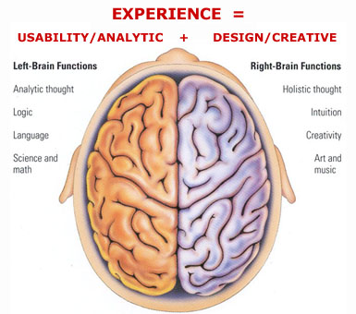
Research results
Kim has a huge section of his brain missing that connects the left and right hemisphere. This is allowing areas of one side of brain to stray off into the other side. They believe this is what is giving the “extra” memory capacity.
He has brain damage to his cerebellum region which regulates attention, language, emotional reactions, pleasure, and fear

Slide 17
“Kim Peek is a living” Google he is a mixture of disability and brilliance!
He completed a high school curriculum at 14 years old
He can read around 8 large books a day.
He can remember number strands 2-3 times longer than the average adult.
He can sing and play music
He has 12,000 books in his memory, and can recall them
Unlike other savants, Kim has abilities in all of the five major areas instead of just one.
Kim can rattle off any zip code or area code if you give him the town
He is a “Kimputer” he soaks up everything, 98% of what goes in stays in. (average adults only retain 45%)
He memorizes maps in the front of phone books
He can identify 1000’s of compositions, when they were composed, the composer, and their bibliography

Slide 18
As a child
Kim would constantly have red forehead from running with it on floor
He was reading index volumes and had memorized the first 8 by 2 years old
He would read 20-30 books a day @ 3 years old, then he would turn them upside down
He started memorizing definitions in the dictionary
His favorite place became the local library, where he would spend most of his time

Slide 19
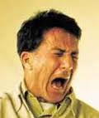
His genius comes with a price!
He cannot follow simple instructions
He gets distraught and has a panic attack, he will smack himself on the head and pace back and forth
His emotions are erratic and unexpected
He is socially outgoing, but he has poor social skills
He cannot learn new strategies, nor can he problem solve
He cannot dress himself, or perform any daily personal tasks.
He cannot pay attention most of the time
He cannot control emotions or reactions
(like shown in the movie)

Slide 20
In the end
It is definitely proven that Kim led a full life! The movie “Rain Man” brought him out of hiding and allowed the world to see thru his eyes. Because of this research, we have a whole new understanding of savants and people with disabilities. Kim's father took care of him every minute of his life. Towards the end there was a fear of Kim outliving his father and who would take care of him. This fortunately did not happen. Fran was the most loving, patient person, and the best person for Kim.

Slide 21
Lawrence kim peek
NOVEMBER 11, 1951
TO
DECEMBER 19, 2009
Kim suffered a heart attack and passed away in 2009

